Slide 1
Hacker101 CTF

Slide 2
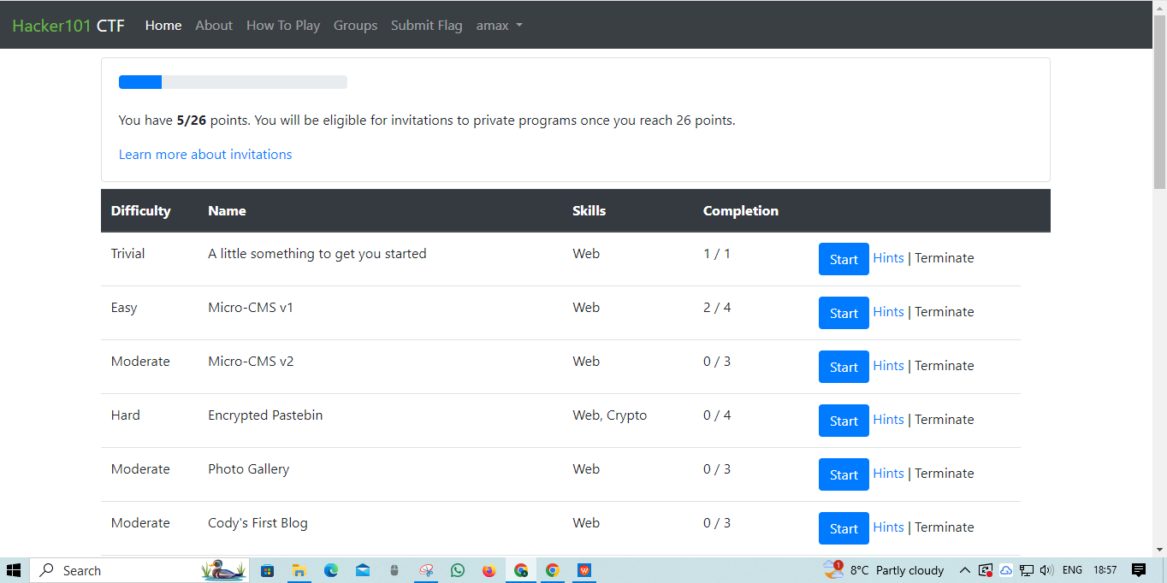
first web challenge which has a 'trivial' difficult The first challenge is (A little something to get you started) to start your challenge press “Start”

Slide 3
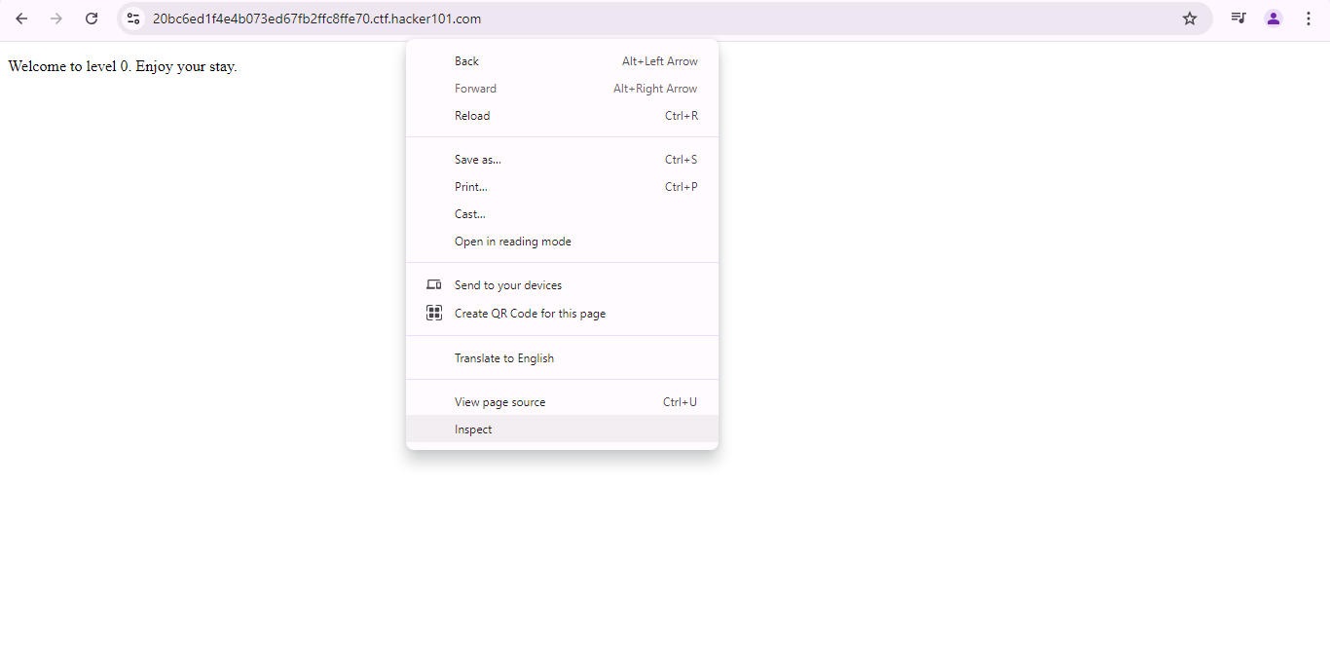
Next step you will see an massage (Welcome to level 0. Enjoy your stay.) so to find the flag , write click and press “Inspect”

Slide 4
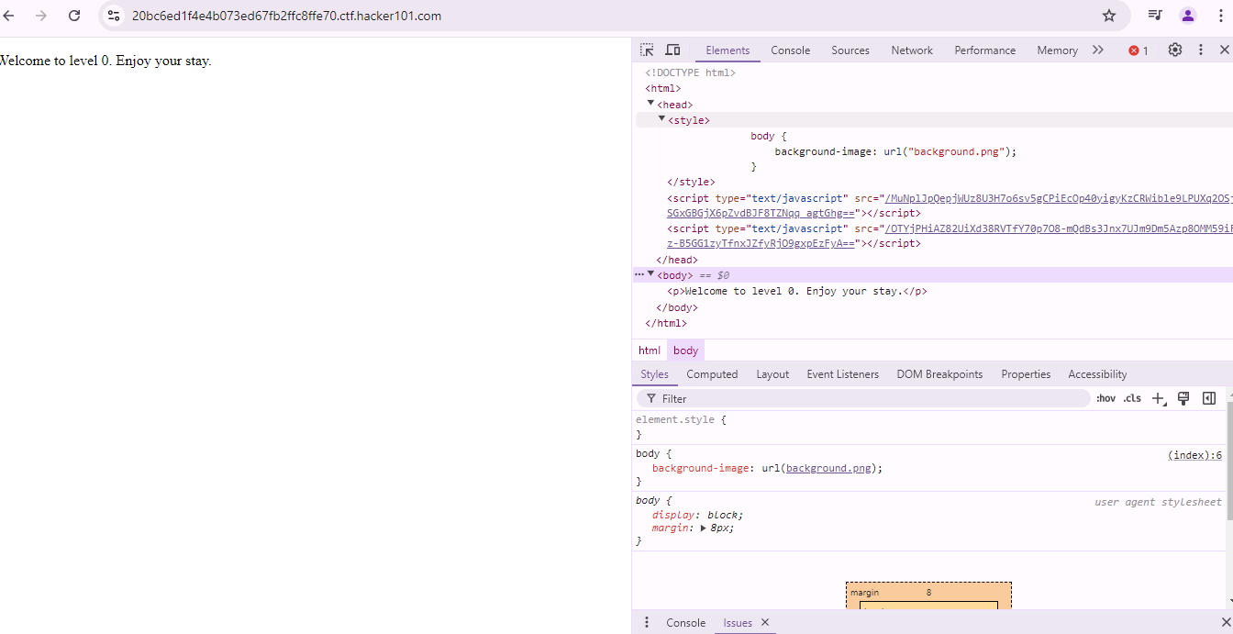
Next step is to expand head,style , body , Notice there something is not right with background-image: url("background.png");

Slide 5
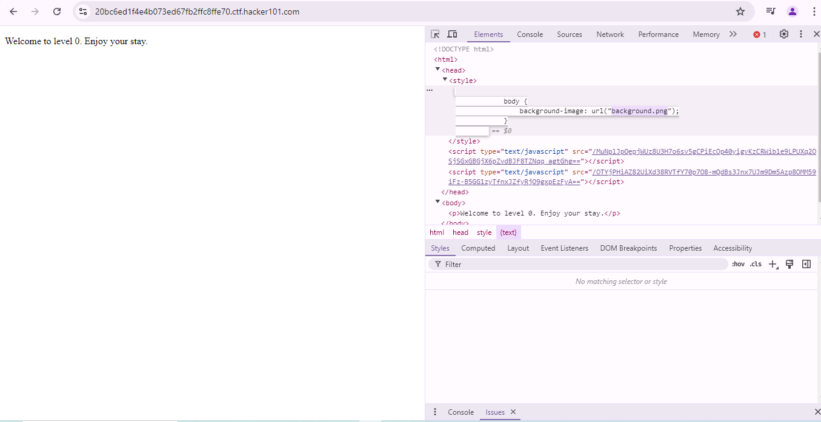
Next step select a sentence background.png then right click and select copy

Slide 6
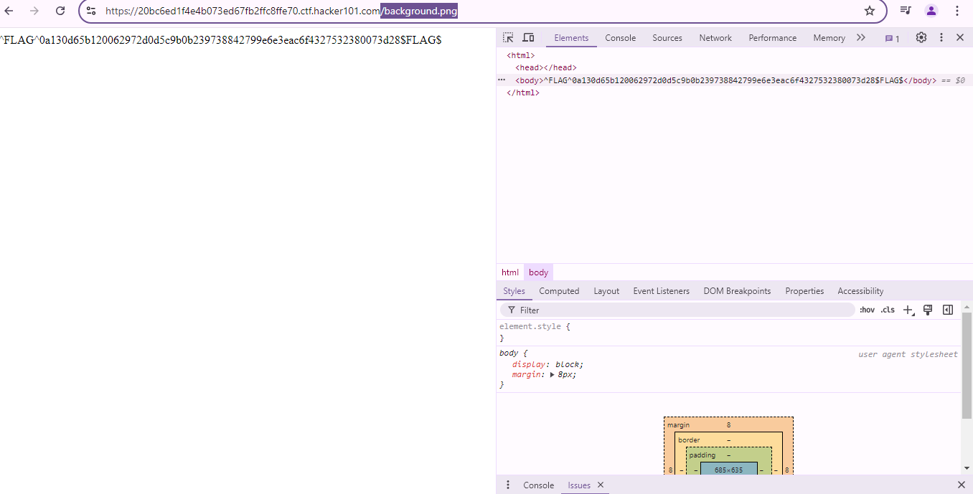
Next step is to paste in URL address and then press enter and you will see the Flag

Slide 7
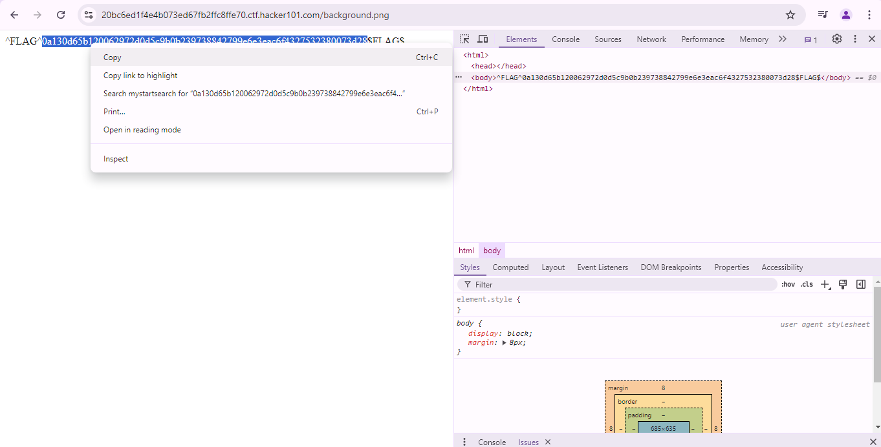
Next step is to copy the code in the flag as showen in the picture

Slide 8
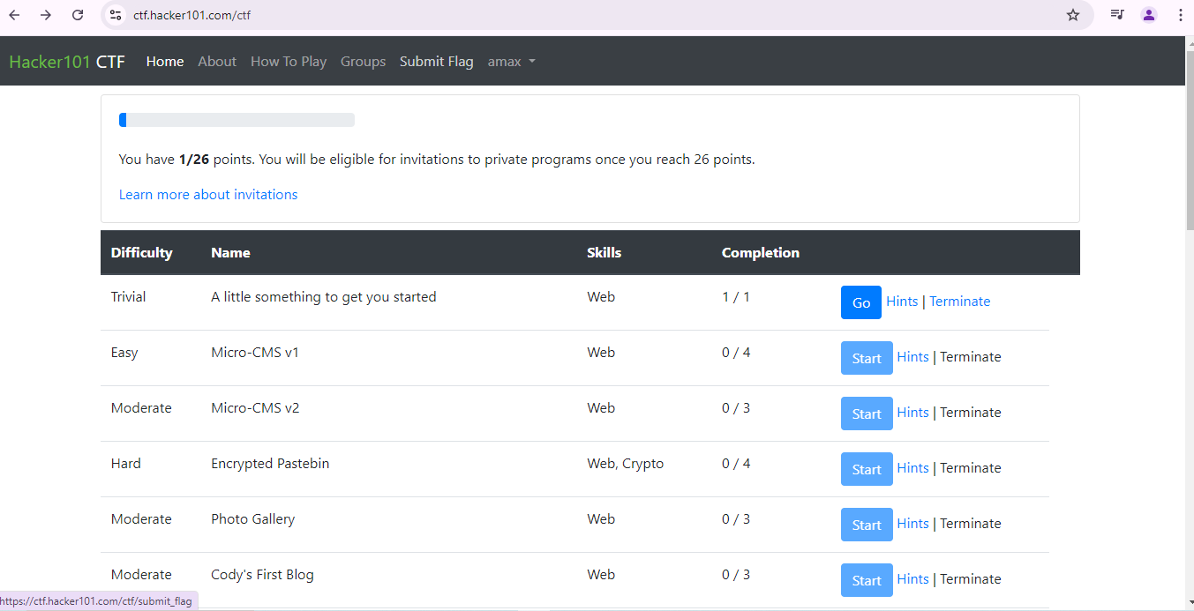
Next step is to go back in the main page and select submit Flag

Slide 9
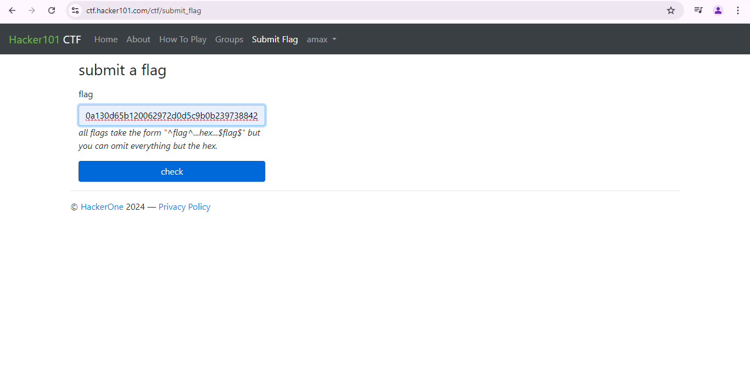
Next step is to paste the code and press check

Slide 10
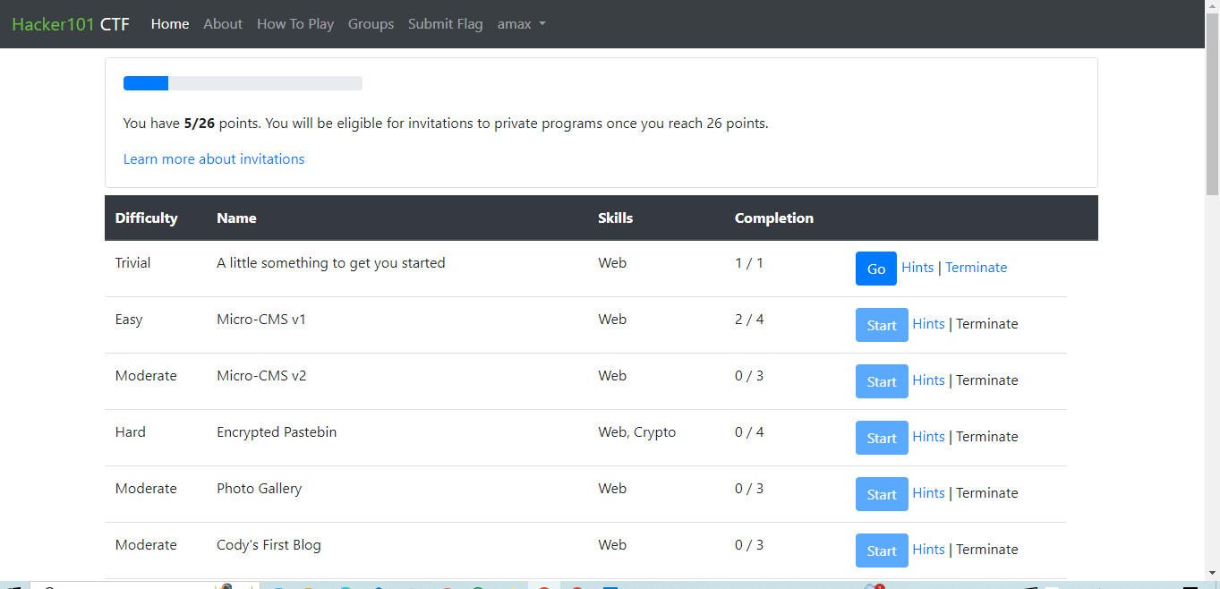
In the Main page will see you complated the first challange.

